Slide 1

CC-215 Database Systems
— Unit 11 — Database Design
Some slides and/or pictures are adapted from Lecture slides / Books of
Peter Rob
Jeffery. A. Hoffer
Thomas M. Connolly
Ramez Elmasri
Silberschtaz
Dr. Asif Sohail University of the Punjab Department of Information Technology, FCIT

Slide 2
Introduction
Database deign of creating a design that will support the organization’s objectives for the required database system.
Approaches to database design
Top-down Approach
Bottom-up Approach
Phases of database design
Conceptual database design
Logical database design
Physical database design

Slide 3
a) Top-down Approach (Design by Analysis)
It starts with a number of groupings of attributes into relations that exist together naturally, for example, an invoice.
The relations are then analyzed through normalization.
One may start with the development of ER model, beginning with the identification of entities and relationships between the entities, which are of interest to the organization.
The ER model is then transformed into a set of relations using the appropriate rules for conversion.

Slide 4
b) Bottom-up Approach (Design by Synthesis)
It begins with the fundamental level of attributes, which through analysis of the associations between attributes, are grouped into relations.
The process of Normalization is used to find the normalized relations based on functional dependencies between the attributes.
The bottom-up approach is appropriate for the design of simple databases with relatively small number of attributes.
This approach becomes difficult to use with a larger number of attributes, where it is difficult to establish all the functional dependencies between the attributes.

Slide 5
Phases of Database Design
a) Conceptual Database Design
The process of constructing a model of the data used in an enterprise, independent of all physical considerations, such as the target DBMS software, application programs, programming language, hardware platform etc.
The data model is built using the user’s requirements specification document. It consists of the following steps:
Identify entity types and the associated attributes
Identify relationship types and the associated attributes
Determine the attributes types and the domains
Determine candidate, primary, and alternate key attributes
Consider use of enhanced modeling concepts (optional step)
Check model for redundancy
Validate conceptual data model against user transactions
Review conceptual data model with user

Slide 6
Phases of Database Design
b) Logical Database Design
The logical data model is based on the target model for the database, such as the relational data model.
Normalization technique is used to test the correctness of the logical data model.
Logical database design consists of the following steps:
Derive relations for logical data model
Validate relations using normalization
Validate relations against user transactions
Check integrity constraints
Review logical data model with user
Merge logical data models into global model (optional step)
Check for future growth

Slide 7
Phases of Database Design - Physical Database Design
The process of producing the description of the database on the secondary storage.
Physical database design is tailored to a specific DBMS.
Logical database design is concerned with what, physical database design is concerned with how.
Physical database design consists of the following steps:
Design base relations
Design representation of derived data
Design integrity constraints
Design file organization and indexes
De-normalization
Design user views
Design security mechanism
Coding and Compression Techniques
Analyze transactions
Partitioning
Estimate disk space requirements

Slide 8
Physical Database Design
Design base relations
For each relation defined in the logical data model, we have a definition consisting of:
The name of the relation and its attributes
Key attributes
Integrity constraints
For each attribute, we have:
Its domain, consisting of its data type, length, and any constraint on the domain
An optional default value for the attribute
Whether the attribute can hold nulls?
Whether the attribute is derived and, if so, how it should be computed?

Slide 9
Physical Database Design
Derived Data
Whether a derived attribute is stored in the database or calculated every time it is needed is a tradeoff. The designer should calculate:
The additional cost to store the derived data and keep it consistent with operational data.
The cost to calculate each time it is required.
The less expensive option is chosen subject to performance constraints.
Derived attribute should be stored when:
A frequent query is made against it.
The DBMS’s query language cannot easily calculate the derived attribute.

Slide 10
Physical Database Design
Data Integrity Constraints
Constraints are designed to enforce business rules and the correctness of data.
The constraints defined at physical database design can greatly reduce the programming effort at the application level.
We can introduce constraints such as DEFAULT value, CHECK constraint, Referential Integrity, database triggers etc.

Slide 11
Physical Database Design – File Organization
A database is mapped into a number of different files that are maintained by the underlying operating system.
A file is organized logically as a sequence of records that are mapped onto disk blocks.
Fixed length records
Variable length records
The simplest file organization is to store the records as per the sequence of insert operations.
Possible actions in response to a delete operation?
Move the record that comes after it into the space formerly occupied by the deleted record, and so on, until every record following the deleted record has been moved ahead.
Move the final record of the file into the space occupied by the deleted record
Wait for a subsequent insertion to utilize the space occupied by the deleted record. This requires additional structure (file header).

Slide 12
Physical Database Design – File Organization
File header or file descriptor contains metadata of a file plus the address of the first deleted record.
The addresses of the deleted records are maintained in link list as shown in the figure below.

Slide 13
Physical Database Design – File Organization
Variable Length Records
The representation typically has two parts: an initial part with fixed-length information, whose structure is the same for all records of the same relation, followed by the contents of variable-length attributes.
Variable-length attributes are represented by a pair (offset, length), where offset denotes where the data for that attribute begins within the record, and length is the length (in bytes) of the attribute.
Consider a relation EMP (ID, eName, job, sal). The attributes are ID, eName, job are variable-length attributes, and sal is fixed length attribute of 8 bytes.
Assuming that the offset and length use 2 bytes each, representation of a variable length record of EMP is shown below.
Bit 1 in NULL bitmap at a certain position indicates NULL value of an attribute.

Slide 14
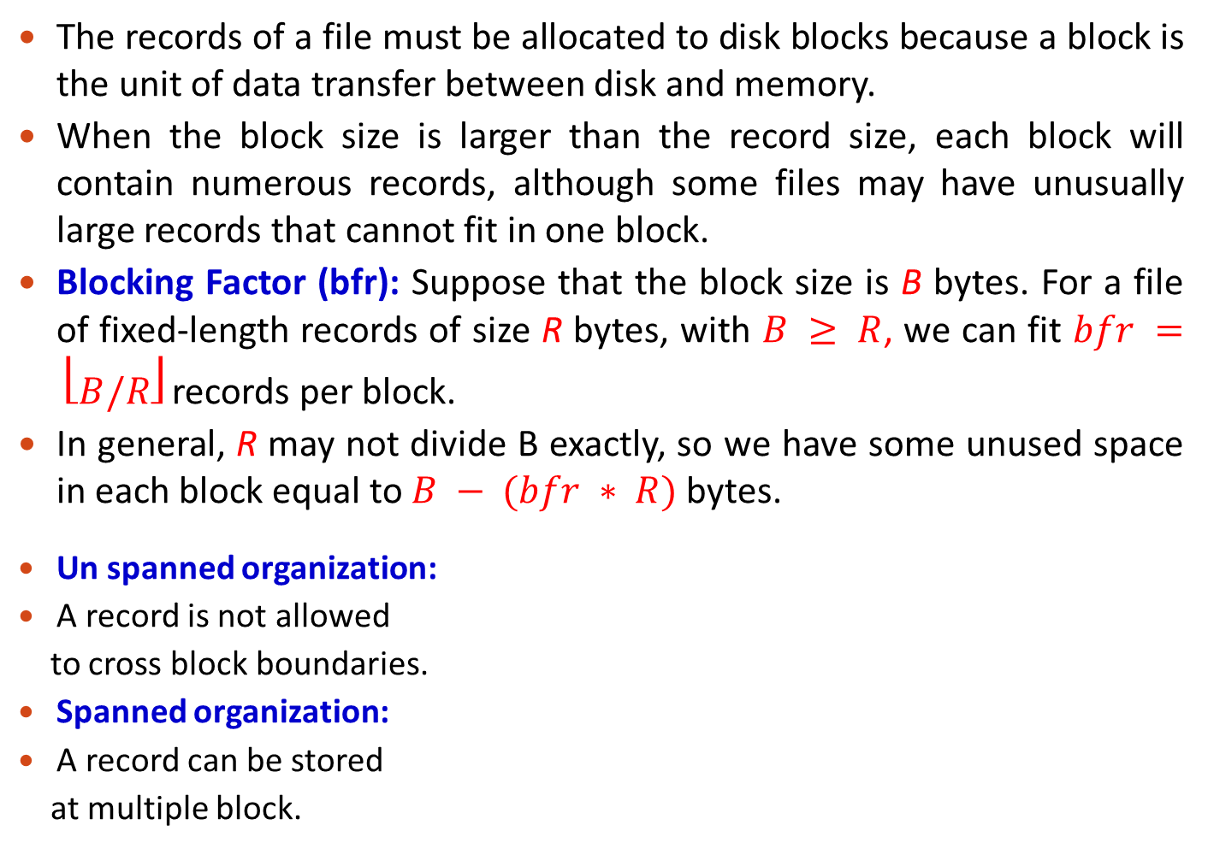
Record Blocking
The records of a file must be allocated to disk blocks because a block is the unit of data transfer between disk and memory.
When the block size is larger than the record size, each block will contain numerous records, although some files may have unusually large records that cannot fit in one block.
Blocking Factor (bfr): Suppose that the block size is B bytes. For a file of fixed-length records of size R bytes, with $B ≥ R$, we can fit $bfr = ⎣B/R⎦$ records per block.
In general, R may not divide B exactly, so we have some unused space in each block equal to $B − (bfr ∗ R)$ bytes.
Un spanned organization:
A record is not allowed
to cross block boundaries.
Spanned organization:
A record can be stored
at multiple block.

Slide 15
File Organization
Record Blocking
The blocks of a file can be allocated on the disk in the following ways:
a) Contiguous Allocation: The file blocks are allocated to consecutive disk blocks. This makes reading the whole file very fast, but it makes expanding the file difficult.
b) Linked Allocation: Each file block contains a pointer to the next file block. This makes it easy to expand the file but makes it slow to read the whole file.
c) Cluster Allocation: It is a combination (a) and (b).
It allocates clusters of consecutive disk blocks, and the clusters are linked. Clusters are sometimes called file segments or extents.
d) Indexed Allocation: One or more index blocks contain pointers to the actual file blocks.

Slide 16
Physical Database Design – File Organization
Records Organization
The records of a file can be organized on the disk in the following ways:
1. Heap or pile or unordered file: Any record can be placed anywhere in the file where there is space for the record. There is no ordering of records.
2. Sequential or sorted file: Records are stored in sequential order, according to the value of a "sort key" of each record.
3. Indexed Sequential file.
4. Hashed file: Place of a record is determined using a hash function applied to a particular field called hash key“.

Slide 17
Organization of Records in Files
Insertion in Sequential file
Locate the record in the file that comes before the record to be inserted in search key order.
If there is a free record (i.e., space left after a deletion) within the same block as this record, insert the new record there.
Otherwise, insert
the new record in an
overflow block.
If too many overflow
blocks are generated
over time, the file
should be reorganized.

Slide 18
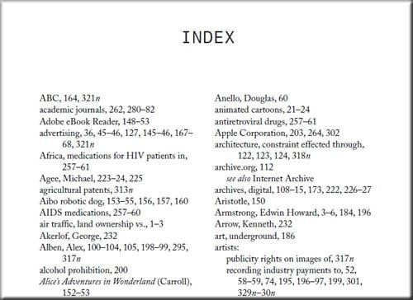
File Organization - Indexing
Sequential file organization are good for searching, but involves a significant overhead of keeping it sorted. An alternate is to maintain an index on the file.
In many cases, a RDBMS may give little or no choice for choosing file organization, although some may be established as indexes are specified.
Indexing enable quick data access based on particular attribute(s) known as
index key(s).
Indexes provide secondary pathways to access records without changing their physical position in the main file.

Slide 19
File Organization - Indexing
Indexes can be established on any relation field, be it primary key or non-key. An index on primary key is called primary index and an index on non key is called secondary index.
A primary index is specified on the ordering key field of an ordered file of records. If the ordering field is not a key field – then it will be called a clustering index.
A file can have at most one physical ordering field, however, each attribute can have a dedicated index file (secondary index), i,.e., multiple index files may exist for one main file.
The index file is always sorted, irrespective of the main file's order. An index is useful for an attribute:
Used most often for join operations.
Used most often to access the tuples in a relation.
Frequently involved in ORDER BY/GROUP BY clause.
Contains a wide range of values.

Slide 20
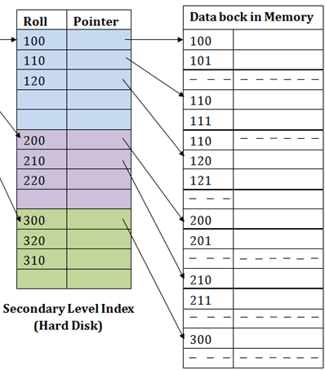
File Organization - Indexing
An index file record contain only two columns; index key and block pointer (base address of the block of main file which contains the record holding the key).
The total number of entries in the index is the same as the number of disk blocks in the ordered data file. The first record in each block of the data file is called the anchor record of the block, or simply the block anchor

Slide 21
File Organization - Indexing
Dense vs Sparse Index
A dense index has an index entry for every search key value (and hence every record) in the data file. This makes searching faster but requires more space to store index records itself.
A sparse (or nondense) index, on the other hand, has index entries for only some of the search values. A sparse index has fewer entries than the number of records in the file.
A primary index is a nondense (sparse) index, since it includes an entry for each disk block of the data file and the keys of its anchor record rather than for every search record.

Slide 22
Physical Database Design
Denormalization
Denormalization is a technique to move from higher to lower normal forms of database modeling in order to speed up database access.
A fully normalized database schema can fail to provide adequate system response time due to excessive table join operations.
Denormalization results in combining two relations into one relation. More specifically, in this step, we consider duplicating certain attributes or combining relations together to reduce the number of joins required to perform a query.
As a general rule of thumb, if performance is unsatisfactory and a relation has a low update rate and very high query rate, denormalization may be a viable option.

Slide 23
Physical Database Design
Denormalization
Denormalization Situation 1:
Many to many binary relationships mapped to three relations.
EMP (empID, eName, job, Sal)
PROJ (pjId, pjName)
WORK (empID, pjId, dtHired)
By de-normalizing these relations, we merge the WORK relation with PROJ relation. In this case it is violating 2NF and anomalies of 2NF would be there, but there would be only one join operation involved by joining two tables, which increases the efficiency.
EMP (empID, eName, job, Sal)
PROJ (pjId, pjName, empId, dtHired)

Slide 24
Denormalization
Denormalization Situation 2:
We have attributes that are almost always used together in application and they end up in different relations, then we will always have to perform a join operation when we retrieve them.
Example: Consider the following relation:
EMP (empID, eName, street, postcode, city)
The relation has a transitive dependency postcode -> city.
After converting the above relation into 3NF, we have
EMP (empID, eName, street, postcode)
LOCATION (postcode, city)
However, this would mean that we would have to do a join whenever we want a complete address for a person. In this case, we would settle for 2NF and implement the original EMP relation.
An alternative is to additionally store the join of EMP and LOCATION as a materialized view (A view whose result is stored in the database and brought up to date when the relations used in the view are updated.)

Slide 25
Physical Database Design
Design user views
A View is a subset of the database that is presented to one or more users.
A view is often referred to as a virtual table.
Views are created to satisfy the requirements of multiple users in an efficient way.

Slide 26
Database Access Control
Database access control is the process of making sure that data or other resources are accessed only in authorized ways.
Access Control Matrix or Authorization Table is used to describe the access type or actions that a database user can perform on a given database object.
It expresses the Authorization Rules in the form of a table or matrix that include Subject, Object & Privileges.
SUBJECT | Student Table | Result Table | Faculty View | Adm. Procedure | CREATE TABLE
User A | Read | Read | Null | Null | No
User B | Read/ Write | Read | Read | Execute | Yes
Role A | All | All | Read, Write, Update | Execute, Alter | Yes

Slide 27
Physical Database Design
Database Access Control
The Column Headings represent database objects, which may be tables, Views, Sequence, Indexes etc.
The Subjects are written on the left side of the table. It may be an individual or a group of users.
The Cell entries of the table specify the privileges. These include INSERT, UPDATE, DELETE, ALTER, SELECT
Once the Authorization table or Access Control Matrix is complete, the DBA grants the privileges accordingly.

Slide 28
Physical Database Design
Coding and Compression Techniques
Coding techniques are useful for compression of data values, by replacing those data values with the smaller sized codes.
Consider the following relation:
EMP (EmpNo, Ename, Job, City,…….)
If we have large number of records, then the wastage of small amount of space in each record can lead to loss of huge amount of data storage space.
To avoid the above problem, we can use the following relations:
EMP (EmpNo, Ename, JobCode, CityCode,…….)
Job (JobCode, JobTitle)
City (CityCode, CityName)

Slide 29
Physical Database Design
Analyze Transactions
For efficient database design, it is necessary to have knowledge of the transactions that will run on the database. It includes the identification of frequent transactions, the transactions that are critical, peak load time etc.
The most active 20% of user queries account for 80% of the total data access (80/20 Rule).
Transaction relation cross-reference matrix shows the operation a transaction performs on a certain relation.
Transaction usage map diagrammatically indicates which relations are potentially heavily used.
The above information is used to select appropriate file organizations and indexes.

Slide 30
Physical Database Design
Transaction / relation cross-reference matrix
I = Insert; R = Read; U = Update; D = Delete
Transaction/ Relation | T1 |  |  |  | T2 |  |  |  | . . . | Tm
 | I | R | U | D | I | R | U | D | . . . | I | R | U | D
R1 | X | X |  |  |  | X | X |  | . . . |  | X
R2 | X |  |  |  |  | X |  | X | . . . | X | X | X
. . . | . . . | . . . | . . . | . . . | . . . | . . . | . . . | . . . | . . . | . . . | . . . | . . . | . . .
Rn |  |  |  | X | X | X |  |  | . . . |  | X

Slide 31
Physical Database Design
Partitioning
It splits a relation into two or more relations.
It is primality used in distributed databases.
A Distributed Database is a single logical database that is spread across computers in multiple locations that are connected by a data communication network.
The objective is to place the partitions at the appropriate sites for optimizing the following parameters.
Ease of data access
Reduced communication cost
Reduced communication cost
Balance workload
Efficiency
There are two types of partitioning; Horizontal Partitioning and Vertical Partitioning

Slide 32
Physical Database Design
a) Horizontal Partitioning
It distributes the rows of a table into several separate tables.
Access time of smaller tables is less than the time to accessing the records of a larger table.
It also helps in the maintenance of tables, security, authorization and backup.
These smaller partitions can also be placed on different disks to reduce disk contention.
b) Vertical Partitioning
It distributes the columns of a table into several separate tables place them at the appropriate sites.
Primary key is repeated in all vertical partitions of a table to get the original table.
You can replicate a limited subset of a table's columns to other machines.

Slide 33
Physical Database Design
Estimate disk space requirements
This step is required so that the appropriate disk size can be selected.
In general, the estimate is based on the size of each tuple and the number of tuples in a relation.
The growth of the relation should also be taken into consideration.

